Slide 1
SQL and R
Unit V
Data Analysis Using R Programming

Slide 2
SQL
SQL stands for Structured Query Language.
SQL queries are used for interacting with a database.
Using SQL queries we can access and manipulate data stored in the database.
With the help of SQL queries, we can create, read, update and delete data on databases and perform lots more operations on the database.

Slide 3
SQL : R Database Interface (DBI)
The DBI package helps connecting R to database management systems (DBMS).
DBI separates the connectivity to the DBMS into a “front-end” and a “back-end”.
The interface defines a small set of classes and methods similar in spirit to Perl’s DBI, Java’s JDBC, Python’s DB-API, and Microsoft’s ODBC. It supports the following operations:
connect/disconnect to the DBMS
create and execute statements in the DBMS
extract results/output from statements
error/exception handling
information (meta-data) from database objects
transaction management (optional)

Slide 4
SQL : R Database Interface (DBI)
Most users who want to access a database do not need to install DBI directly. It will be installed automatically when you install one of the database backends:
RPostgres for PostgreSQL,
RMariaDB for MariaDB or MySQL,
RSQLite for SQLite,
odbc for databases that you can access via ODBC,
bigrquery,

Slide 5
R Database Interface (DBI) Installation
You can install the released version of DBI from CRAN with:
install.packages("DBI“)
The following example illustrates some of the DBI capabilities:

Slide 6
#Connection using DBI
library(DBI)
# Create an ephemeral in-memory RSQLite database
con <- dbConnect(RSQLite::SQLite(), dbname = ":memory:")
# Listing of tables in DB
dbListTables(con)
# Create of tables in DB
dbWriteTable(con, "mtcars", mtcars)
dbListTables(con)
OUTPUT
[1] "mtcars"

Slide 7
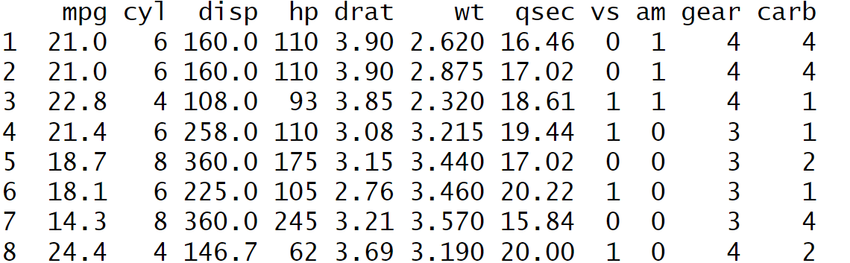
dbListFields(con, "mtcars")
dbReadTable(con, "mtcars")

Slide 8
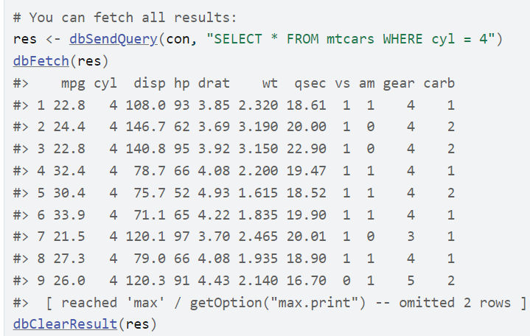

Slide 9
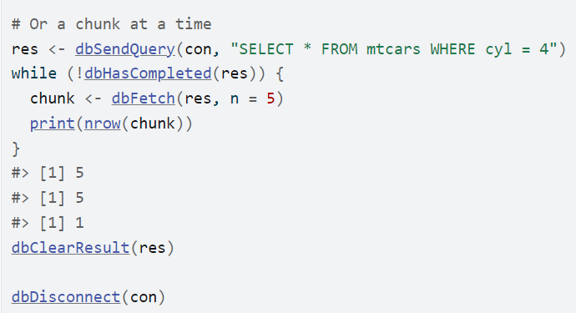

Slide 10
sqldf package
We can also use sqldf package to run SQL queries in R.
Sqldf is a convenient R tool that allows the execution of SQL operations on R data frames.
The databases MySQL, PostgreSQL, H2, and SQLite can all be used with sqldf.
We can run SQL queries in R using sqldf package.
install.packages("sqldf")

Slide 11
sqldf package
Now after the installation of sqldf package we have to import it to use its functionalities.
library(sqldf)

Slide 12
Reading data using SQL query
we are going to use the SQL select command to view the data of the data frame.
First, we import the sqldf library, then read the CSV file and store it into a variable “df” as a data frame.
Select Statement
df <- iris
head(df)

Slide 13
Reading data using SQL query
# Importing sqldf library
library(sqldf)
#Creating Dataframe
df <- iris
# Reading data from data frame using SQL select query
sqldf("select * from df")

Slide 14
Example
In this example, we are going to read a particular column from the data frame by selecting a particular column using the SQL query
sqldf("select [sepal.length], [sepal.width], [Species] from df")
we are using order by clause in SQL select statement due to which our data is displayed by sorting the data of the “sepal_length” column
sqldf("select * from df order by sepal_length")

Slide 15
Example
sqldf("select max(sepal_length) from df")
sqldf("select min(sepal_length) from df")

Slide 16
WHERE
Conditional statements can be added via WHERE
sqldf(“select * from df where species='Iris-virginica’”)

Slide 17
WHERE
Both AND and OR are valid, along with paranthese to affect order of operations.
sqldf('SELECT * FROM rock WHERE (peri > 5000 AND shape < .05) OR perm > 1000')

Slide 18
Example
# Deleting rows where species is Iris-virginica
df<-sqldf(c("delete from df where species='Iris-virginica'", "select * from df"))
print("After delete rows")
# Displaying data frame
sqldf("select * from df")

Slide 19
Example
# Update species name from Iris-versicolor to versicolor
print("Before update")
sqldf("select * from df")
# Updating values
df <- sqldf(c("update df set species='versicolor'
where species='Iris-versicolor'",
"select * from df"))
print("After update")
sqldf("select * from df")

Slide 20
IN
%in% , is used to check if an element exists within a vector, list, or other data structure.
It returns a logical vector indicating whether a match was found
# Check value in a Vector
67 %in% c(2,5,8,23,67,34)
#Check one vector elements in another vector
vec1 <- c(2,5,8,23,67,34)
vec2 <- c(1,2,8,34)
vec2 %in% vec1

Slide 21
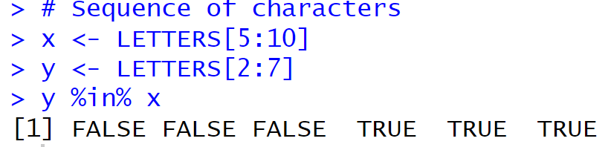
IN

Slide 22
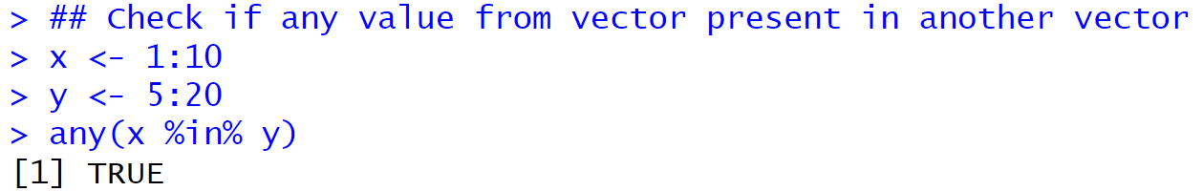
IN

Slide 23
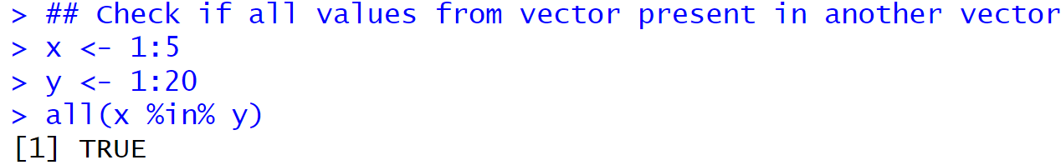
IN

Slide 24
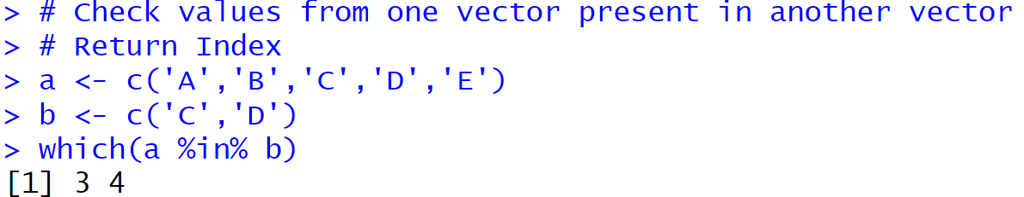
IN

Slide 25
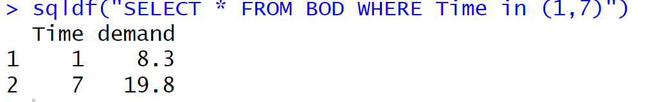
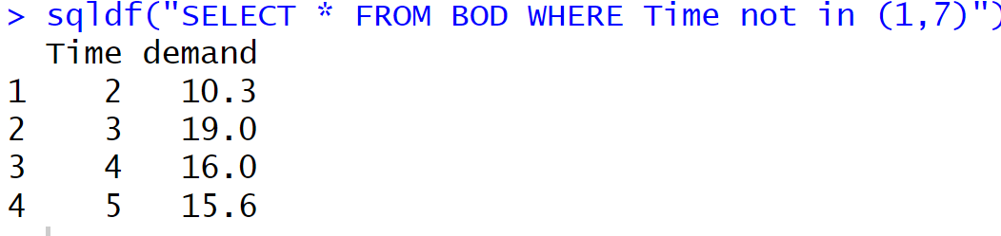
WHERE --IN
WHERE IN is used similar to R’s %in%. It also supports NOT

Slide 26
WHERE --LIKE
LIKE can be thought of as a weak regular expression command.
It only allows the single wildcard % which matches any number of characters.
For example, to extract the data where the feed ends and does not end with “bean”
sqldf('SELECT * FROM chickwts WHERE feed LIKE "%bean" LIMIT 5'
sqldf('SELECT * FROM chickwts WHERE feed NOT LIKE "%bean" LIMIT 5')

Slide 27
Sorting the data using SQL query (Order by Clause)
To order variables, use the syntax
sqldf("SELECT * FROM Orange ORDER BY age ASC, circumference DESC LIMIT 5")
ORDER BY var1 {ASC/DESC}, var2 {ASC/DESC}

Slide 28
LIMIT
To control the number of results returned, use LIMIT #.
sqldf('SELECT * FROM iris LIMIT 10')

Slide 29
Aggregated data
Select statements can create aggregated data using AVG, MEDIAN, MAX, MIN, and SUM as functions in the list of variables to select.
The GROUP BY statement can be added to aggregate by groups.
sqldf("SELECT AVG(circumference) FROM Orange")
sqldf("SELECT max(circumference)AND min(circumference) FROM Orange")
sqldf("SELECT tree, AVG(circumference) AS meancirc FROM Orange GROUP BY tree")

